Slide 1
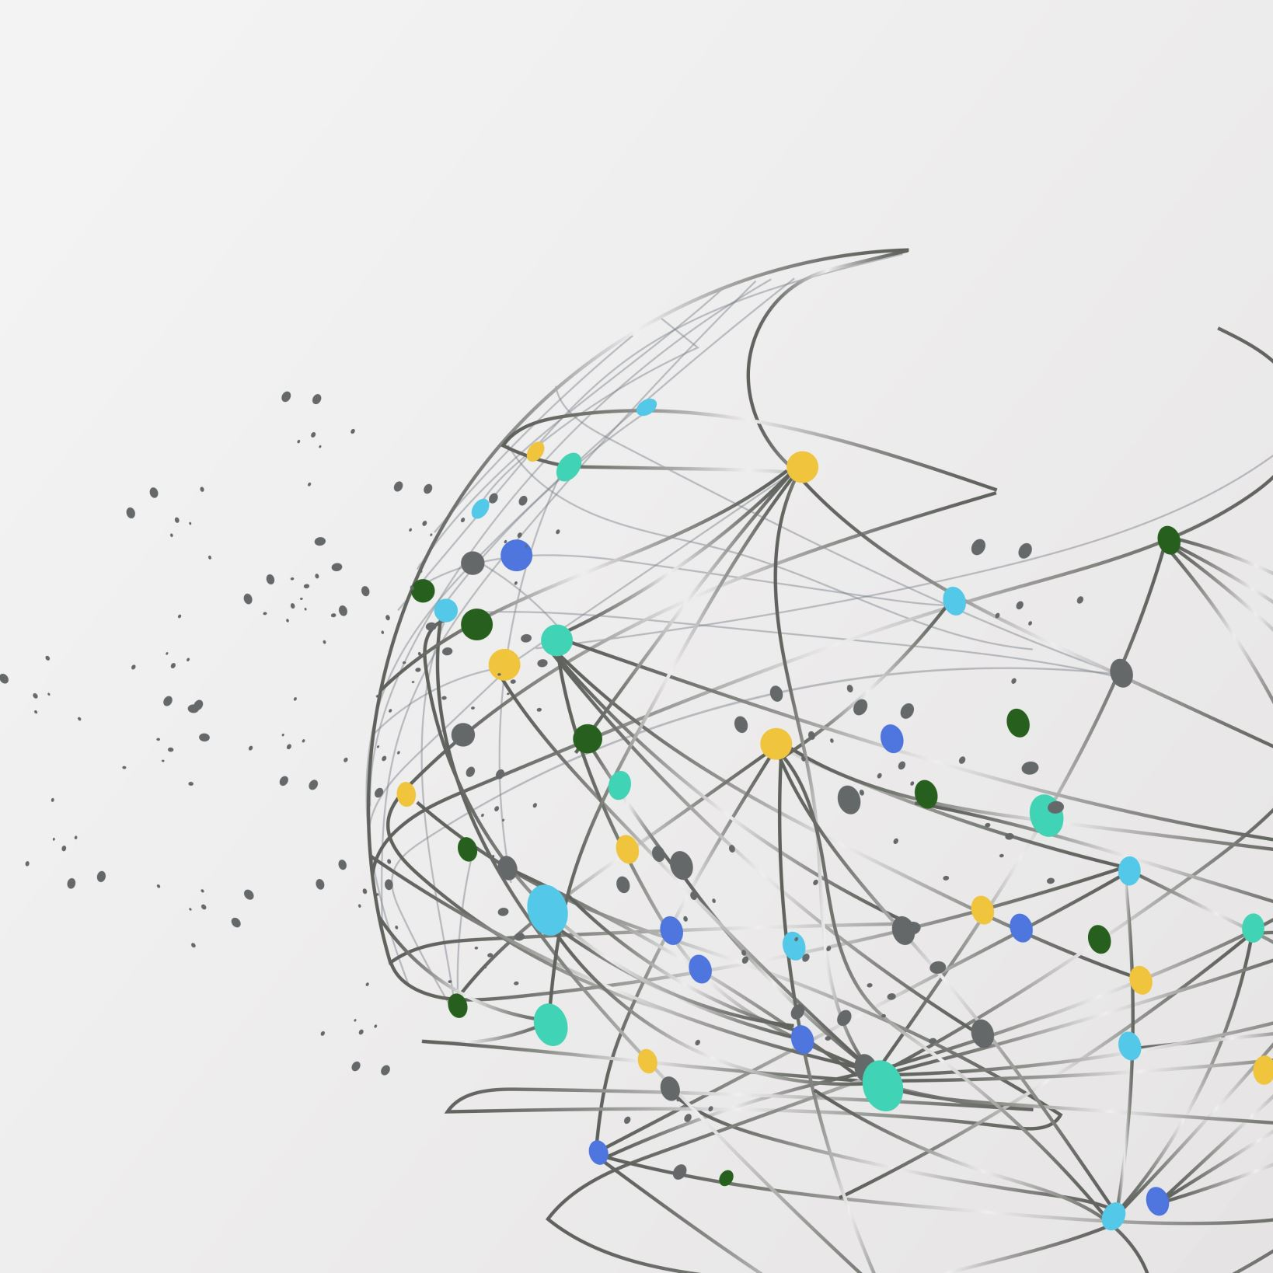
Term Project Demo
Team Members
Avinash Kola
Akhila Awoshetty

Slide 2
Flappy Bird Game Agent
Reinforcement Learning for Autonomous Navigation in Flappy Bird
Developing an autonomous agent capable of navigating through obstacles in the Flappy Bird game using reinforcement learning techniques.

Slide 3
FLAPPY BIRD Game Agent
Implement Flappy Bird game with reinforcement learning for autonomous navigation through obstacles.
Train the agent using policy gradient methods to maximize its score by avoiding obstacles.
Develop an autonomous agent capable of achieving high scores through learned behavior.
Ultimately, create an agent that outperforms handcrafted rule-based approaches, showcasing the power of reinforcement learning in gaming tasks.

Slide 4
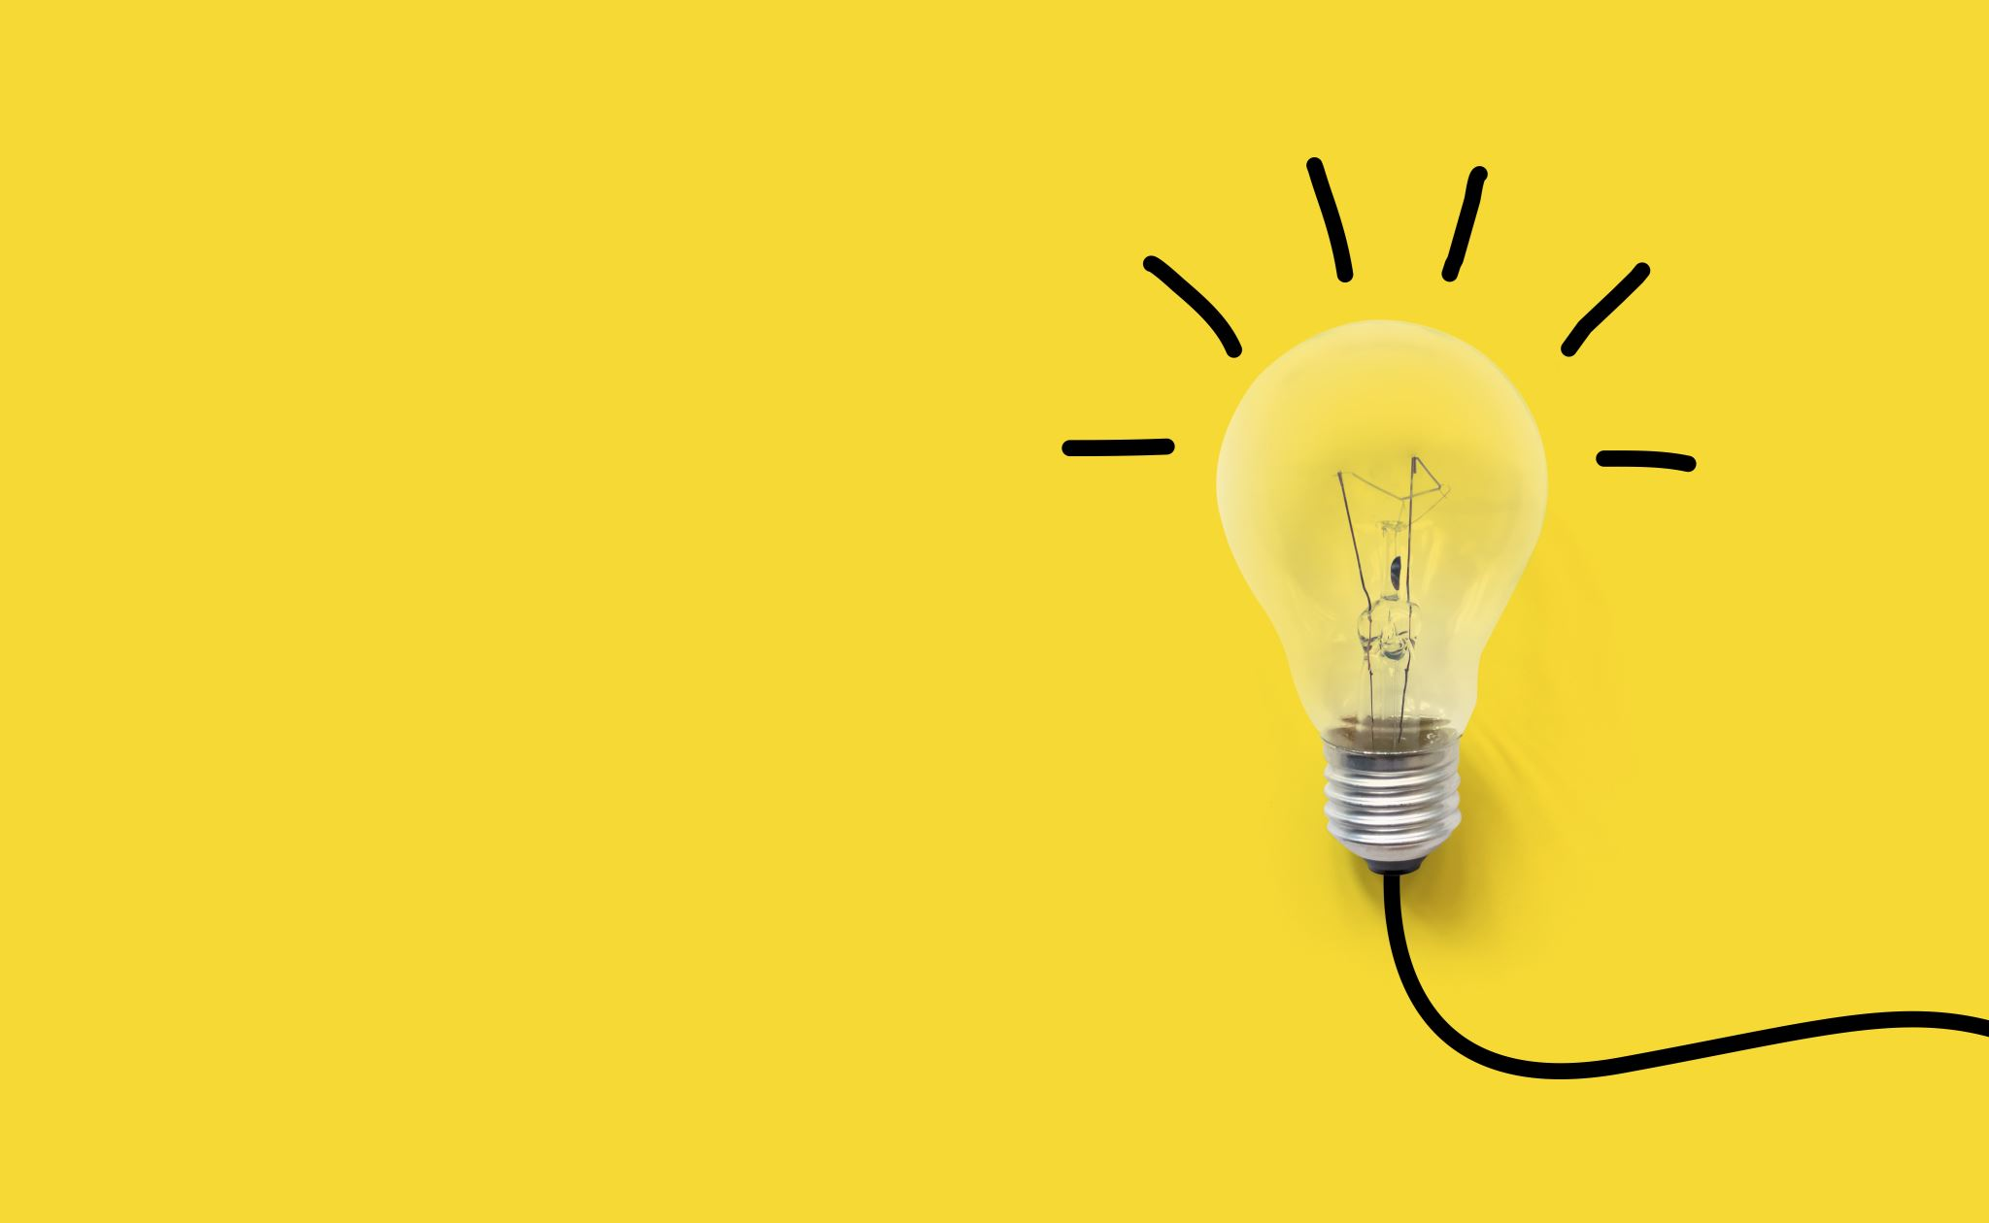
Approach
Game Implementation: Utilize Pygame library to implement Flappy Bird game mechanics, including bird, pipes, gravity, and collision detection.
Reinforcement Learning Integration: Integrate policy gradient-based Q learning RL algorithm with a neural network to determine bird actions based on game state.
Training Procedure: Train the policy network by collecting game states, actions, and rewards over multiple episodes, updating parameters to maximize cumulative reward.
Visualization: Display real-time training progress by visualizing the game screen during training to monitor agent behavior and learning dynamics.

Slide 5

Files Structure of the project
There are one file that contains all the code including the Algorithm and the Game UI
Requirements
Python 3.10 version
PIP (performance improvement plan) for libraries
installation.
PyGame - It is an open-source Python programming language module created to support the creation of multimedia apps and games

Slide 6

Major Algorithm used
Q-learning is a reinforcement learning algorithm focused on maximizing cumulative rewards by determining the best actions to take in different states of an environment.
It operates on the basis of Q-values, representing the value of each action in each state, which are iteratively updated using observed rewards and the maximum Q-value of the next state.
The algorithm continues updating Q-values until it converges to the optimal policy, enabling efficient decision-making in complex environments.

Slide 7
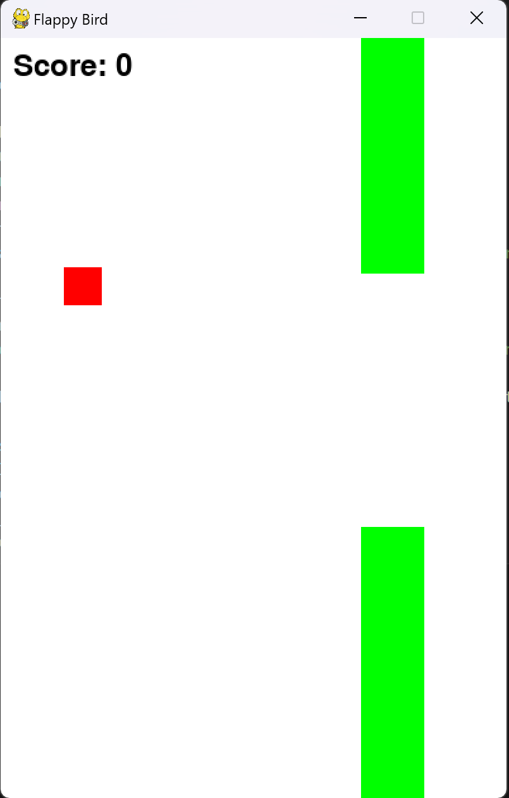
Project Pictures

Slide 8
Deliverables
Complete Flappy Bird Game Implementation: Developing a Pygame-based Flappy Bird game with classes for bird, pipes, game environment, and mechanics.
Reinforcement Learning Integration: Integrating RL algorithm into the game, incorporating policy network implementation and training procedure.
Visualization of Training: Providing visual representation of training progress, including game screen display during episodes and dynamic tracking of learning advancements.

Slide 9
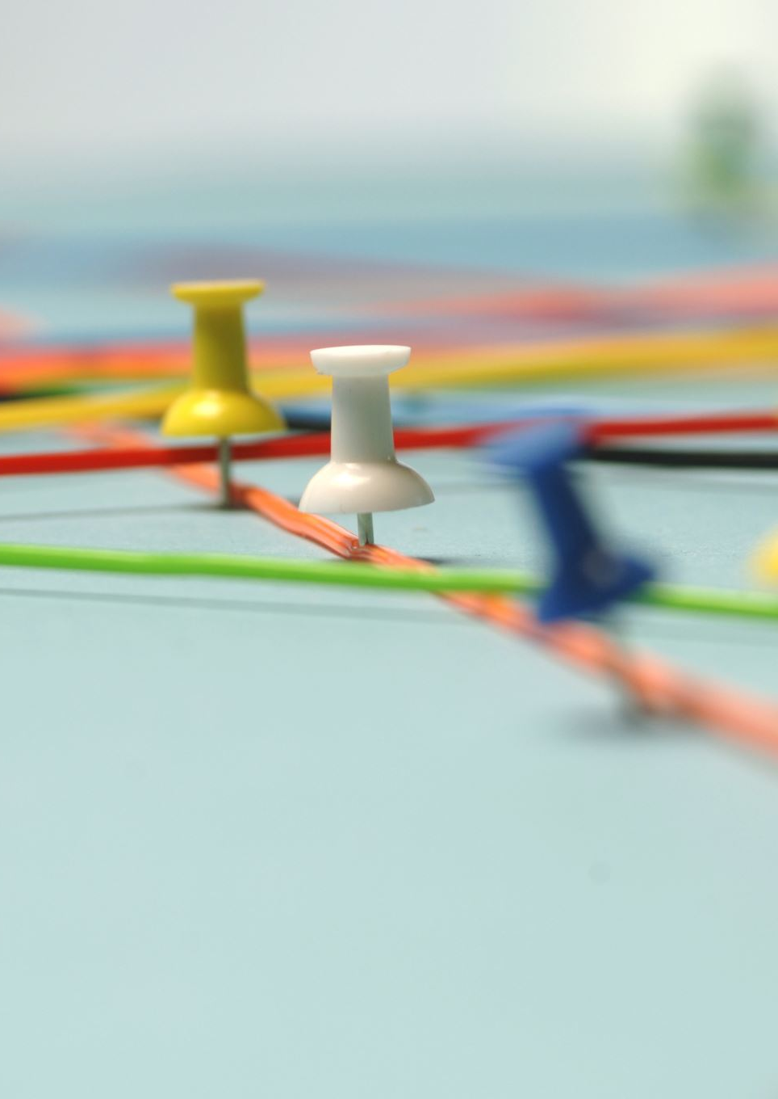
Evaluation Methodology
Game Performance: Assess agent's ability to attain high scores in Flappy Bird game as an indicator of its learning and navigation proficiency.
Learning Progress: Monitor agent's improvement over time by visualizing game screen during training episodes, focusing on enhanced navigation through pipes and avoidance of collisions.
Training Metrics: Track training metrics including average episode reward and loss to gauge reinforcement learning algorithm effectiveness and policy network training performance.
Comparative Analysis: Optionally, compare learned agent's performance with a baseline agent utilizing handcrafted rules or random actions to showcase the efficacy of learned behavior.

